Slide 1
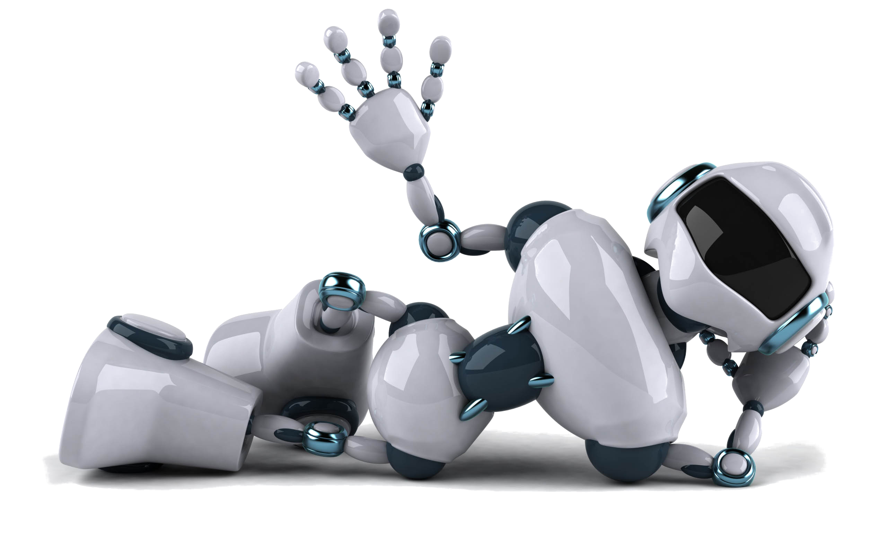
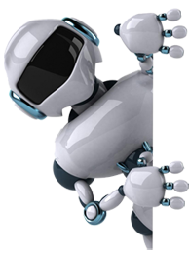
I Robotics
Date: DD/MM/JJJJ

Slide 2
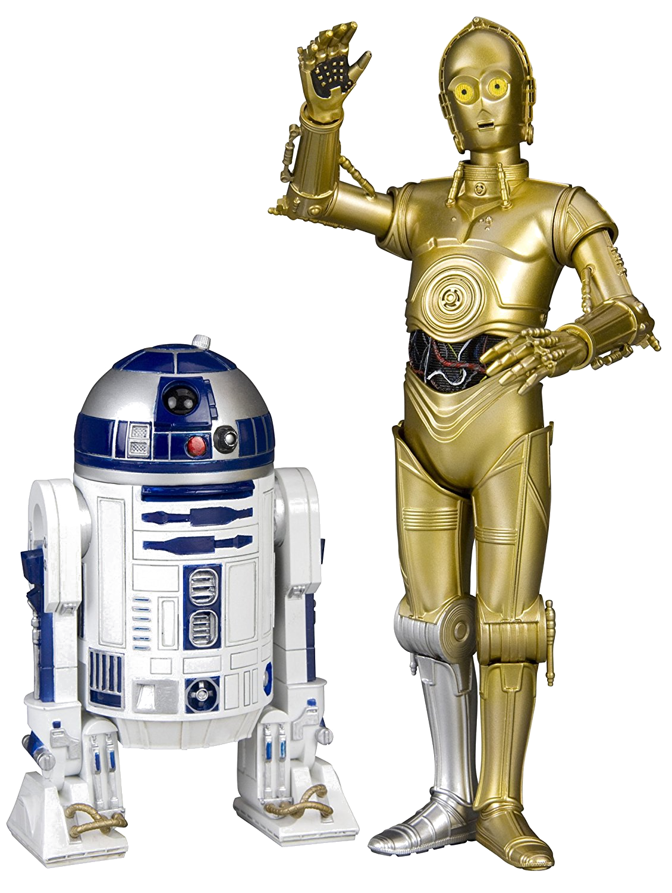
R2-D2 and C-3PO
Star wars and all science fiction robots are not true robots, they can talk, walk and do things people can do

Slide 3
Video 1
Real robots today are designed for specific tasks transporting people and cars assembling products in a factory and they can only do the specific tasks for which the were designed.
This means they don't look always like human, don't talk, walk etc their shapes and sizes are designed to fit the specific tasks they do.
Robots definition: Robots are automated devices that perform physical tasks in the real world!

Slide 4

Daniela Rus Introduction to robotics
Robots have potential to improve the quality of life(at school, at home...), to power the economy and generally make the word better
The objective of robotic is not to replace humans, it is to find ways for machines and humans to be more effective together
Machine could become trusted partner this is a future we are building.

Slide 5
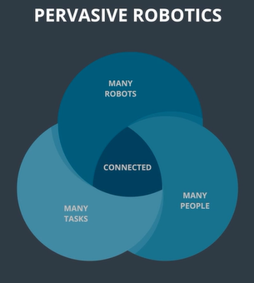
The future we are building is the world of pervasive robotic connect word of many robots working with many people doing many tasks.
Robots puts computation in motion Robots are programmable mechanical devices that take inputs from the world through sensors and impact the world through their actuators
Robots come in many different shapes
Humanoid shapes are not the only, robot can be a car, a shopping cart, a garbage, a device to deliver a package....

Slide 6
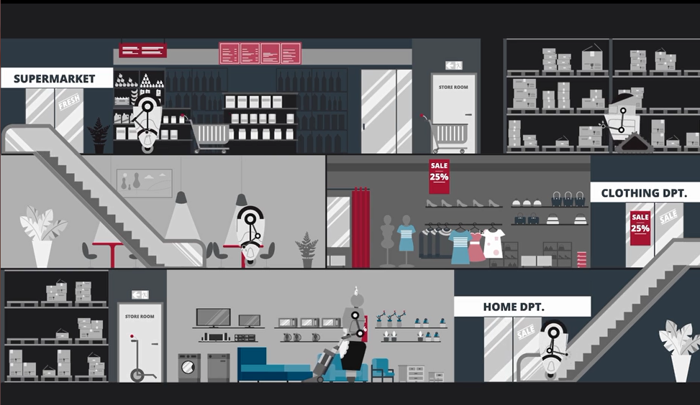
Example of automation could lead in the future to a completely new shopping experience.
Robots can deliver packages, clean up, move things around,
Robots have to sense, compute, and move in support of their tasks, they have all to interact with each other and with people in support of their coordination tasks

Slide 7
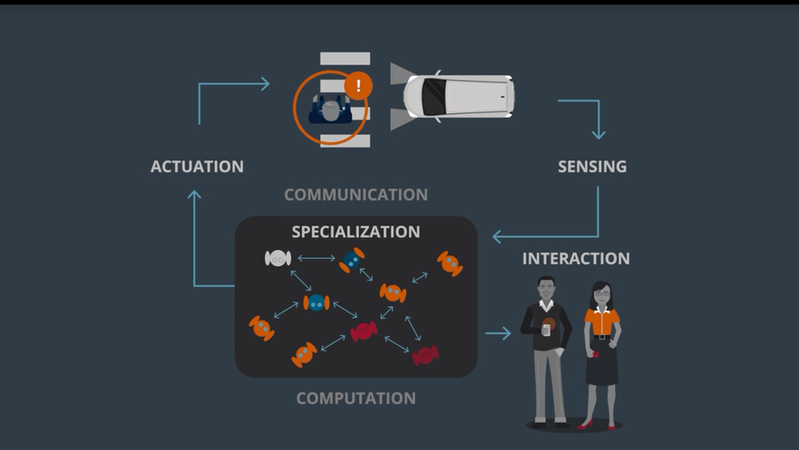

Slide 8
Computation has improved dramatically, power of computing doubles every 2 year
Robot are bodies and brains
Bodies are formed from of Mechanisms that include:
Computation
Sensing
Actuation
Communication
Brain to control the bodies and this are done by algorithms

Slide 9
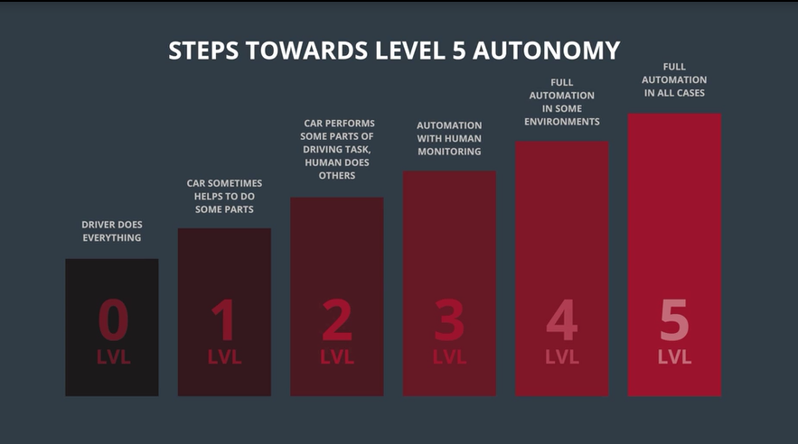
Autonomous driving is an example on how driving will evolve is an extraordinary path
transportation will become an Utility

Slide 10
Video 2: Autonomous systems
DRIVE, SENSE
PHASE I
(ONCE, THEN INCREMENTAL UPDATES)
COMPUTE MAP FOR
CLOSED REGION
PLAN PATH
PHASE II
(EACH RIDE)
DRIVE
Notes:
Video2, Alex

Slide 11
Feature SpaCe
MAPPING
LOCALIZATION
NAVIGATION
PEDESTRIAN DETECTION
PEDESTRIAN INTERACTION
VEHICLE INTERACTION
Notes:
Feature space just refers to the collections of features that are used to characterize your data. For example, if your data is about people, your feature space might be (Gender, Height, Weight, Age) ... Cars?

Slide 12
AUTONOMY ARCHITECTURE
INFRASTRUCTURE
PERCEPTION
SENSING
ESTIMATION
PLANNING/
CONTROLLING
ROBOT
PLATFORM

Slide 13
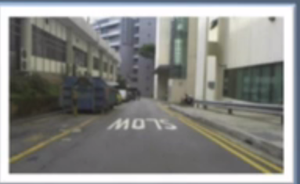
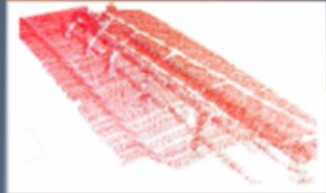

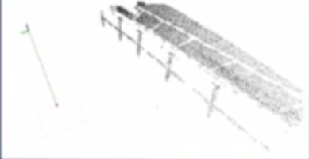
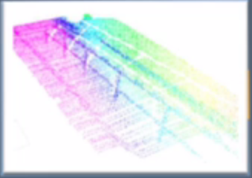
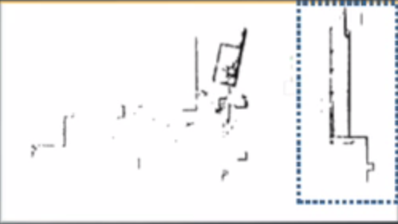
Mapping
Laser Scanners
SURFACE NORMAL
CALCULATIONS
POINT
CLASSIFICATION
INTEREST POINTS
LIDAR accumulation
3D rolling window
SYNTHETIC LIDAR CONSTRUCTION

Slide 14
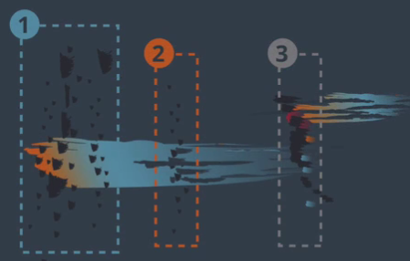
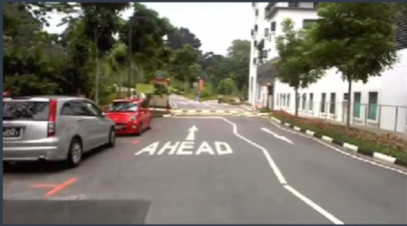
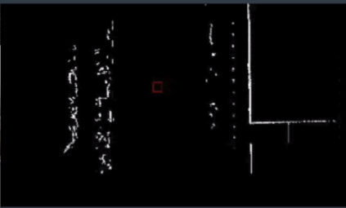
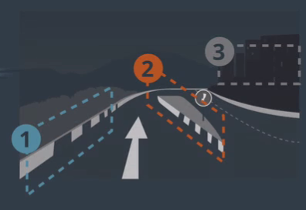
Localization
Surface Normal For Classification
ON-BOARD
CAMERA VIEW
TOP-DOWN
LASER SCAN VIEW
CLASSIFICATION

Slide 15
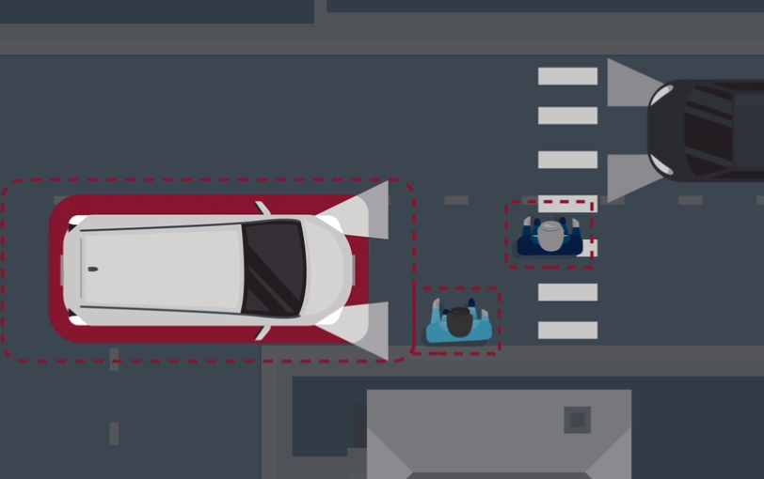
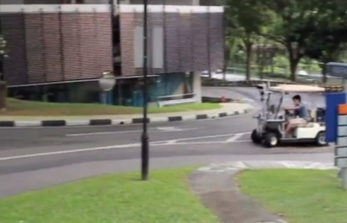
PEDESTRIANS
NAVIGATION & INTERACTION
TRADITIONAL NAVIGATION SYSTEM
DYNAMIC VIRTUAL BUMPER
IMPLEMENTED TRAFFIC RULES
BREAK TRAFFIC RULES

Slide 16
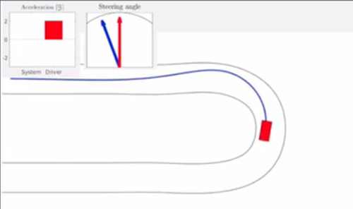
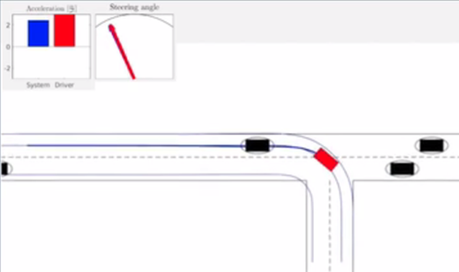
VEHICLE INTERACTION
ConSTRAINT OPTIMIZATION
SHARED CONTROLLER
LOW-LEVEL COMMANDS
SAFE MODIFICATIONS
Notes:
you can see the speed in bars, the steering angle in arrows
blue = decision of autonomy system
red = decision of human

Slide 17
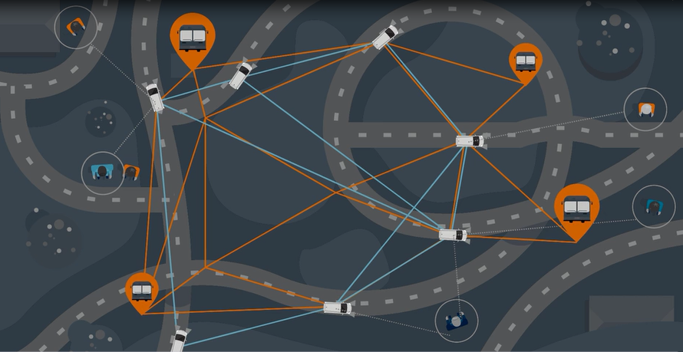
Video 3
A very important activity on automated driving is Transportation on Demand
Transportation to be available anywhere anytime
Mobility on Demand is similar to the concept of Shared Biking.
Autonomous driving enables the approach to shared driving and mobility on demand: the car is able to coordinate with other cars in the system and with the people in order to reach the next passenger that need a ride

Slide 18
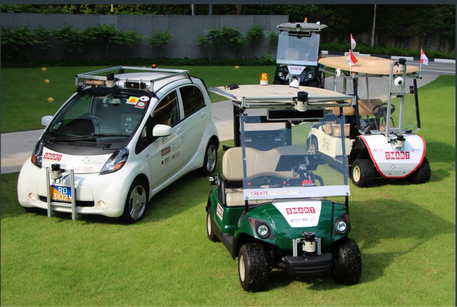
Small trial in Singapore
Autonomous driving System deployed in Singapore Chinese Garden.
The humans were able to book a ride using an App
The Ride was provided at designated place and designated time.
The car was able to drive itself and provide mobility on demand
Fleet of vehicle.

Slide 19
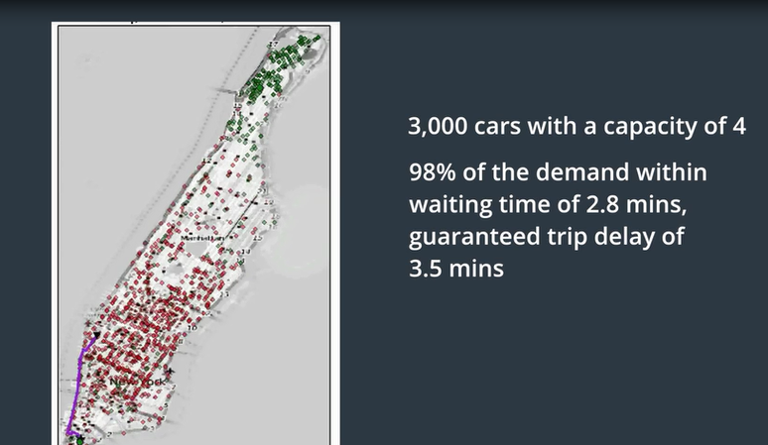
Classical implementation: a vehicle serves one passenger
Next step is the design of an optimal path that allows a single car to take more passengers in a same area reducing the delay as much as possible
Development of an algorithm to optimize requests, available vehicles and number of passengers in a car
Autonomy and drive sharing have the potential to transform transportation in an utility anywhere anytime. improving quality of life in urban center, decreasing pollution, decreasing congestion

Slide 20
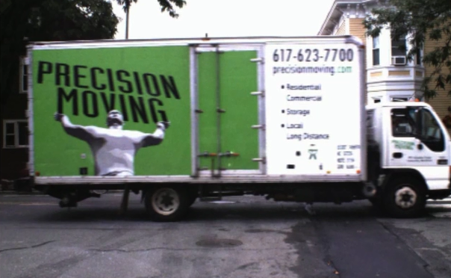
why are this cars not on the road yet?
technological challenges for autonomy:
Technology is still not ready for:
situations of intense congestion
mixed human driven and autonomy systems
travelling in weather because the perception system are not able to match the human perception systems
Even if computer vision has make big progress it remains really challenging the are also big progress challenges

Slide 21
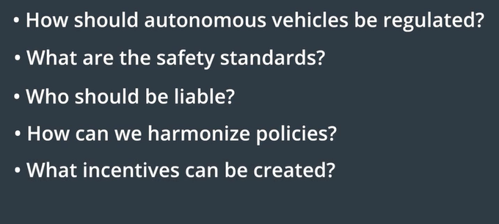
Policy challenges for autonomy

Slide 22
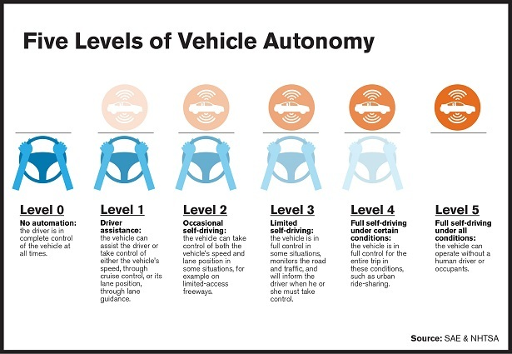
The technology is ready NOW for deployment in a "calm and protected" system NOT in an high complex environment no congestion, few people crossing, limited area
In some number of year we will reach a higher level of maturity
There are multiple steps yet to be achieved to get to level 5 of autonomy

Slide 23

Whole World is on Fire Autonomous driving
TEXT

Slide 24
Video 4
Why is it so difficult for ROBOTICS to walk
Mobility: What´s easy & hard
Three main challenges for Robots
More skills for Robots
Create much faster new Body's
Getting Robots much better between Robots & People
Shared control between Human & Mobility

Slide 25
Whole World is on Fire Autonomous driving
Why is it so difficult for ROBOTICS to walk

Slide 26
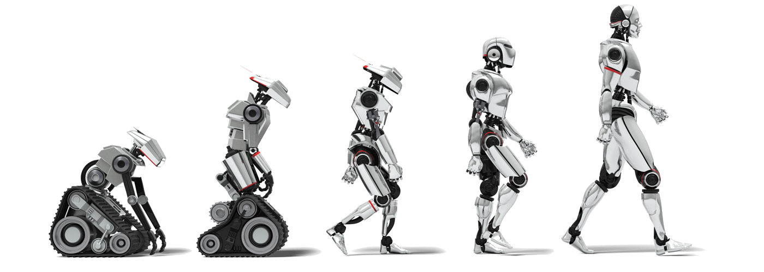
Science fiction “Robots” walks
“Autonomous driving” in other words Robots on Wheels is the Future Peak.
Brain to control the Body to do the Task.
Capabilities of the Body relative to the Task.
Robots needs a very quick reaction
to the surrounding World.
Extraordinary perception.
Negotiate the next steps, Robots needs a very quick reaction, need extraordinary perception

Slide 27
Whole World is on Fire Autonomous driving
What´s easy & hard

Slide 28

Mobility is much easier as manipulation
Easy
Excellent sensors that enable Machines
Good bundle of algorithms
Hard
Movement on congestions streets
Manipulation is challenging
Robots have limited capabilities
Developing Soft Robotics that have Human movements

Slide 29
Whole World is on Fire Autonomous driving
Three main challenges for Robots

Slide 30
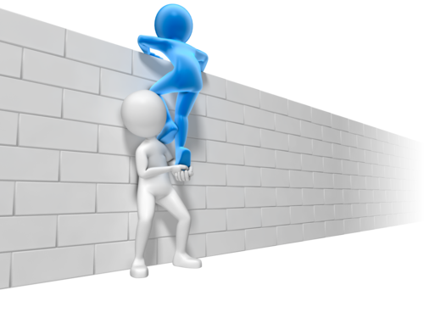
More skills for Robots
Robots could be integrated in human Environment
Work with Human who are not expert
Create much faster new Body's
Ernom time to create new type of Robots
Task Reserved for few experts
Getting Robots much better between Robots & People
Future able to execute a wide range of task

Slide 31
Whole World is on Fire Autonomous driving
Shared control between Human & Mobility

Slide 32
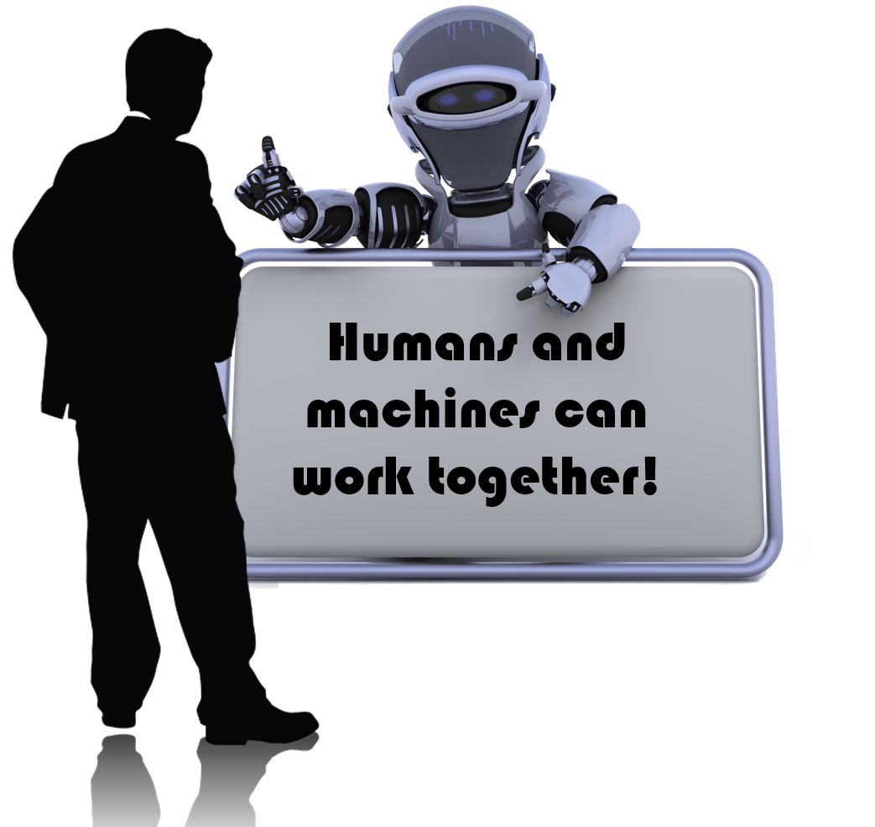
Shared Control between Human & Maschines
Maschines can do much better then Human(See further)
Principal taking advantage what Maschines could do better then People
Could get awareness what´s happening around
Future Working together

